Slide 1
Database Access

Slide 2
Outline
Database recap
DBMS(Database Management System)
ADO.NET
CRUD operations

Slide 3
Database recap
Database store information in records, fields and tables.
You can think of a database as a filling cabinet, organized so that you can retrieve and use the data.
Databases can also be defined as a collection of records stored in a computer in a systematic way, so that the computer system can consult it to answer questions(query).

Slide 4
Database Management Systems(DBMS)
Database Management Systems(DBMS) are computer programs that are used to manage and query a database
Database management systems facilitate storage, retrieval, manipulation and reporting of large amounts of data.
DBMS include MySQL, SQL Server, Oracle, and Microsoft Access.
Many of these DBMSs store data in tabular format and are considered relational databases.
In a relational database, the rows in the table are referred to as records and the columns are the fields of the table.
A field is a single piece of information, such as StudentID or FirstName.
A record is a complete set of fields.
When you have the student identification number, student last name, student first name, phone number, and so on about an individual student, this represents a student record.

Slide 5
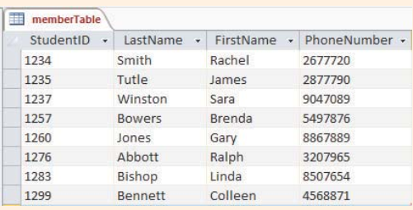
Cont.

Slide 6
ADO.NET
ADO.NET is a data access technology for accessing data and in databases in .NET framework.
ADO stands for ActiveX Data Objects.
It allows us to connect to underlying data or databases. It has classes and methods to retrieve and manipulate data.
The following are a few of the .NET applications that use ADO.NET to connect to a database, execute commands and retrieve data from the database.
ASP.NET Web Applications
Console Applications
Windows Applications.

Slide 7
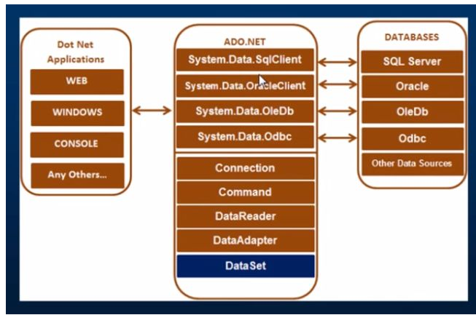
ADO Class Library

Slide 8
Important Classes in ADO.NET
Connection Class
Command Class
DataReader Class
DataAdapter Class
Dataset Class

Slide 9
Connection Class
ADO.NET connection is an object that provides database connectivity and the entry point to a database. When the connection of an object is instantiated, the constructor takes a connection string that contains the information about the database server, server type, database name, connection type, and database user credentials.
ADO.NET provides connection to multiple providers. Each provider has a functionality to connect with different database. Here is a list of data providers in ADO.NET and their purpose.
Data Provider for SQL Server (System.Data.SqlClient).
Data Provider for MS ACCESS (System.Data.OleDb).
Data Provider for MYSQL (System.Data.Odbc).
Data Provider for ORACLE (System.Data.OracleClient).

Slide 10
How to get connection string from SQL Server
https://www.c-sharpcorner.com/article/get-connectionstring-for-sql-server/

Slide 11
Command Class
The Command class provides methods for storing and executing SQL statements and Stored Procedures. The following are the various commands that are executed by the Command Class.
ExecuteReader(): Returns data to the client as rows. It is equivalent to select statement in sql. It returns datareader objects, that can be used to fill a datatable or be printed on to a form.
ExecuteNonQuery() - Executes a command that changes the data in the database, such as an update, delete, or insert statement.
ExecuteScalar(): This method only returns a single value. This kind of query returns a count of rows or a calculated value.

Slide 12
DataReader/DataAdapter/Dataset
DataReader Class: The DataReader is used to retrieve data. It is used in conjunction with the Command class to execute an SQL Select statement and then access the returned rows.
DataSet Class
The DataSet is the heart of ADO.NET. The DataSet is essentially a collection of DataTable objects. In turn each object contains a collection of DataColumn and DataRow objects. The DataSet also contains a Relations collection that can be used to define relations among Data Table Objects.
The DataAdapter Class is used to connect DataSets to databases. The DataAdapter is most useful when using data-bound controls in Windows Forms

Slide 13
CRUD Operations (Create, Read, Update, Delete)

Slide 14
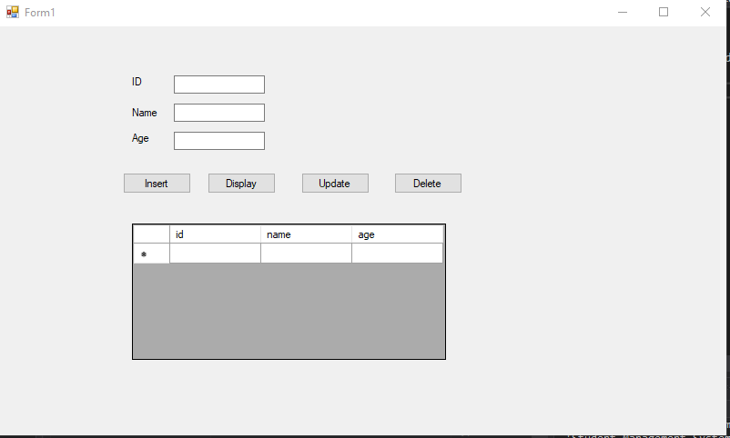

Slide 15
Steps when creating a database
Establishing a connection between your project and the database
Write the sql command
Execute the sql command
Display the result

Slide 16
Establishing a connection(with SQL Server)
Create a new project
Bring up the Server Explorer[View > ServerExplorer]
Click on Data Connections and choose Add Connections
Then in the Data Source dialogue box choose the SQLServer
Provide the Server Name and the Database name

Slide 17
Connection String
Add a header file System.Data.SqlClient
Using System.Data.SqlClient;
Create a connection String
SqlConnection con = new SqlConnection(connection string);

Slide 18
Connection String
Connection string is the string that establishes the connection to the database
You can find different connection string formats from https://www.connectionstrings.com/sql-server/
Components of a connection string
Server/Datasoruce: Servername
Database/Initial Catalog:Database name
Userid: refers to the username
Password: refers to the password

Slide 19
Inserting data in the database
con.Open();
MessageBox.Show("Opened connection");
da.InsertCommand = new SqlCommand("insert into Info Values (@id, @name, @age ) ", con);
da.InsertCommand.Parameters.Add("@id", SqlDbType.Int).Value = int.Parse(id_txtBox.Text);
da.InsertCommand.Parameters.Add("@name", SqlDbType.VarChar).Value = name_txtbox.Text;
da.InsertCommand.Parameters.Add("@age", SqlDbType.Int).Value = textBox1.Text;
da.InsertCommand.ExecuteNonQuery();
con.Close();
MessageBox.Show("Date inserted successfully");
}

Slide 20
Reading data from the database
Establishing a connection
Opening a connection
Execute the sql command
Display the data
MessageBox, Label
DataGridView
Binding datagridview with datatable
Close connection();

Slide 21
Data table
The DataTable class in C# ADO.NET is a database table representation and provides a collection of columns and rows to store data in a grid form.

Slide 22
Updating data
con.Open();
SqlCommand cmd = new SqlCommand("update Info set name = '" +name_txtbox.Text +"' ,age = '"+textBox1.Text +" ' where id='"+id_txtBox.Text+"' ", con);
cmd.ExecuteNonQuery();
con.Close();

Slide 23
Delete records from Database
private void delete_btn_Click(object sender, EventArgs e)
{ DialogResult d = MessageBox.Show("Do you want to delete?", "Confirmation", MessageBoxButtons.YesNo,MessageBoxIcon.Warning);
if (d == DialogResult.Yes) { {
con.Open();
SqlCommand cmd = new SqlCommand("Delete from Info where id ='" + this.id_txtBox.Text + "'", con);
cmd.ExecuteNonQuery();
MessageBox.Show("deleted successfully");
con.Close();
}
else
MessageBox.Show("dialoge box doesn't work");

Slide 24
Troubleshooting
SqlClient not recognized.
In .NET Core, you need to add a reference to System.Data.SqlClient via NuGet:
Select Tools | NuGet Package Manager | Manage NuGet Packages for Solution
Click "Browse"
Type System.Data.SqlClient and hit return
Select System.Data.SqlClient by Microsoft
On the panel on the right, check your project.
Click Install
Click OK to the next box that comes up.

